Slide 1
0627
John

Slide 2
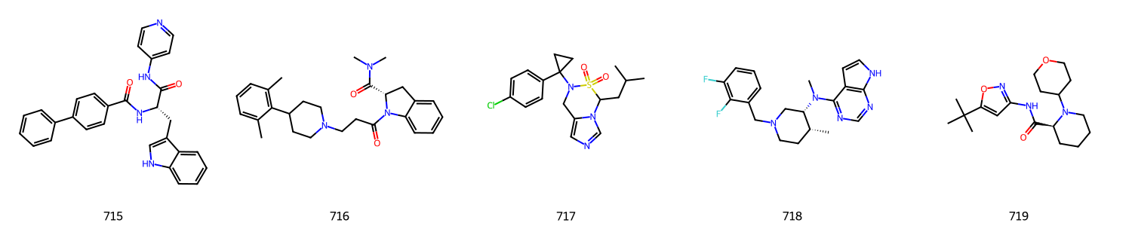
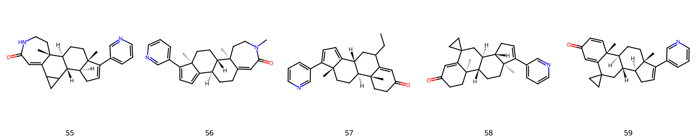
N=3 ring, Total: 67

Slide 3
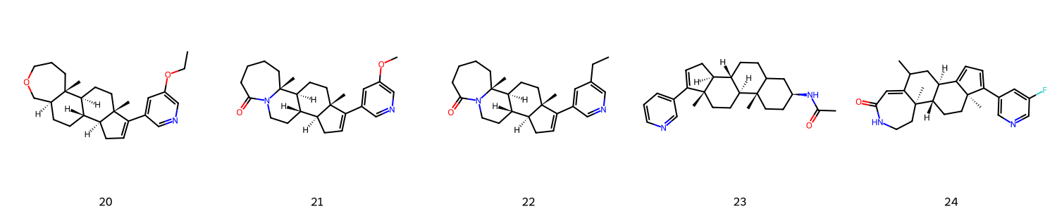
N=7 ring, Total: 87

Slide 4
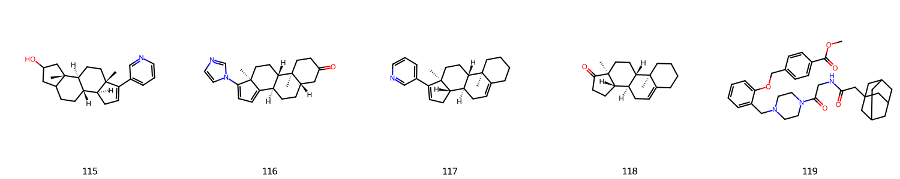
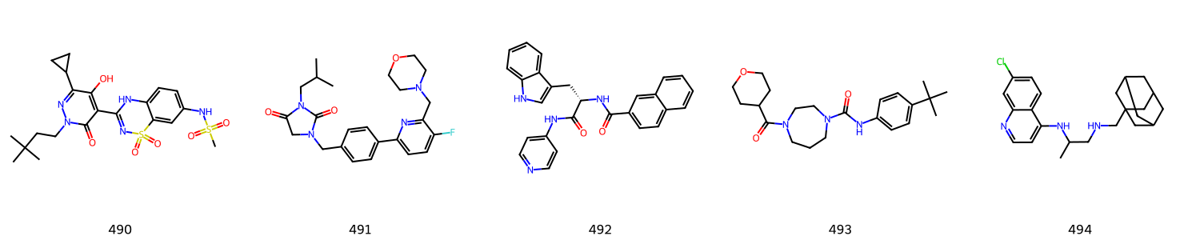
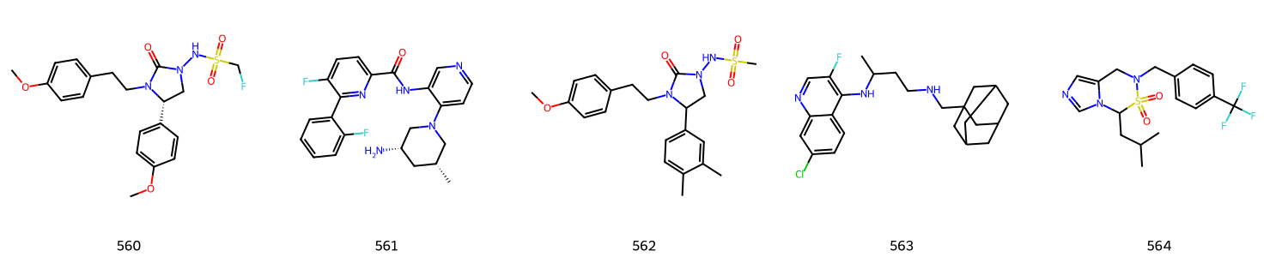
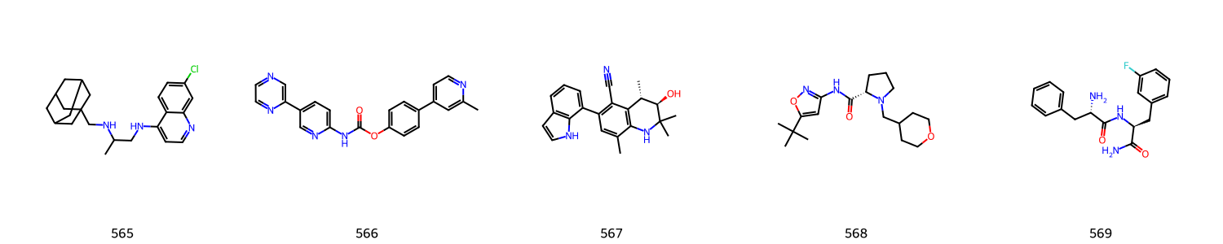
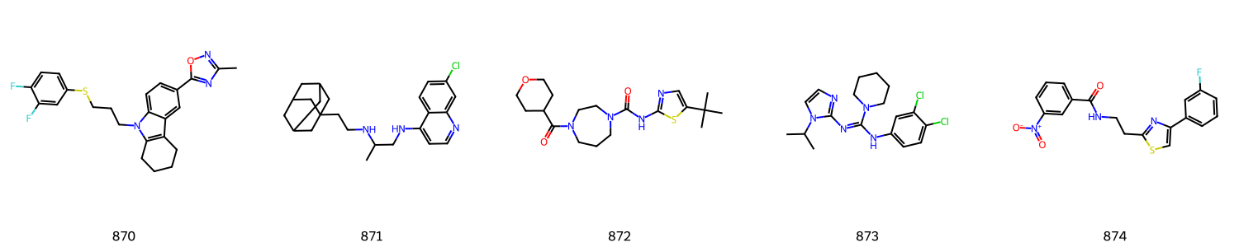
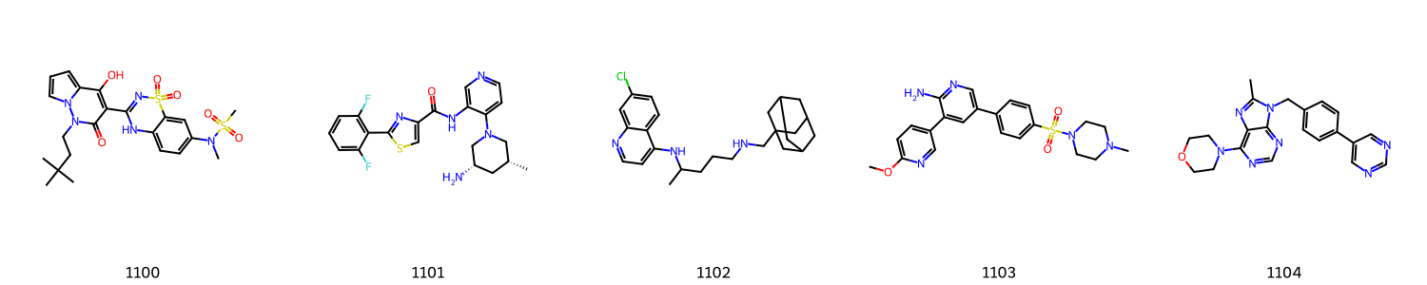
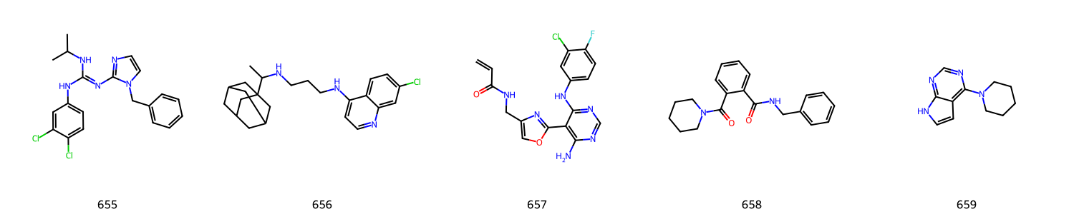
Total:12

Slide 5
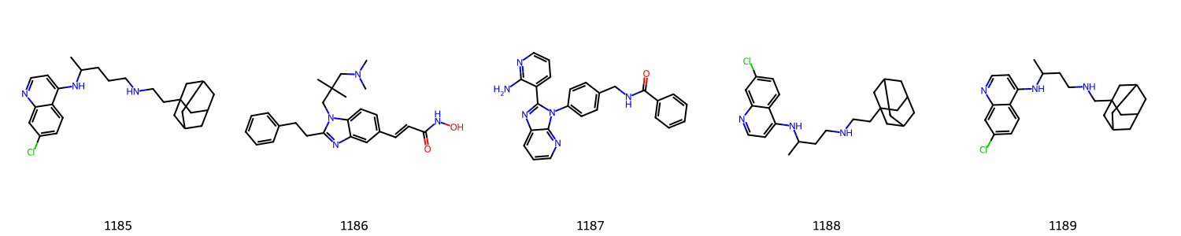
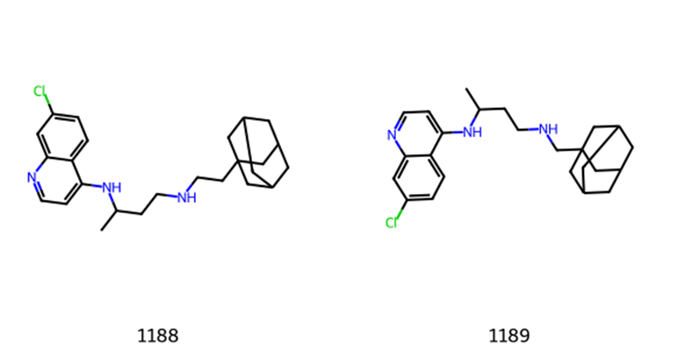
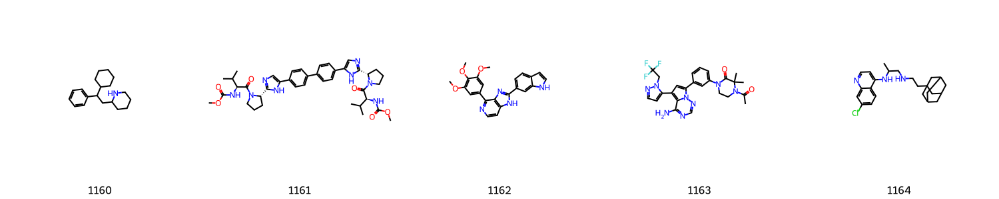
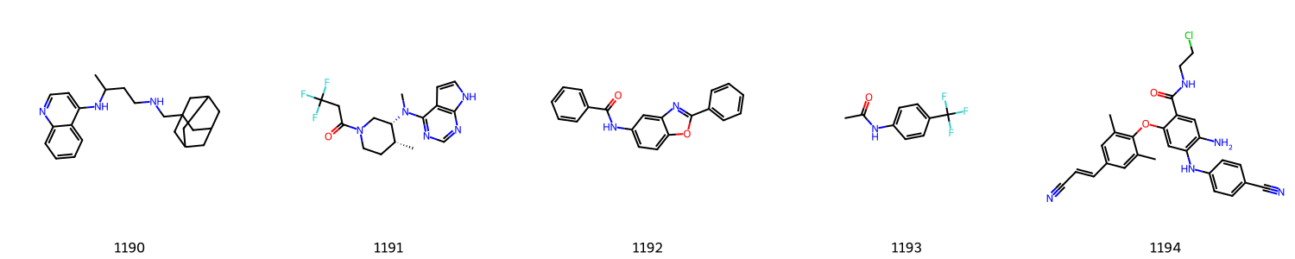

Slide 6
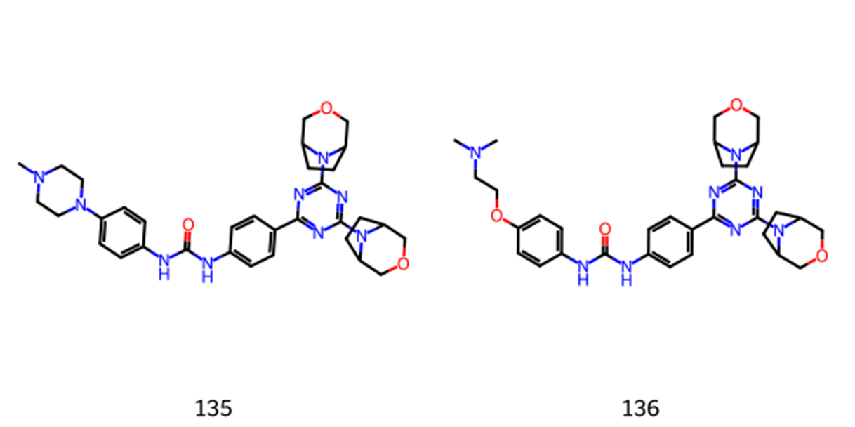
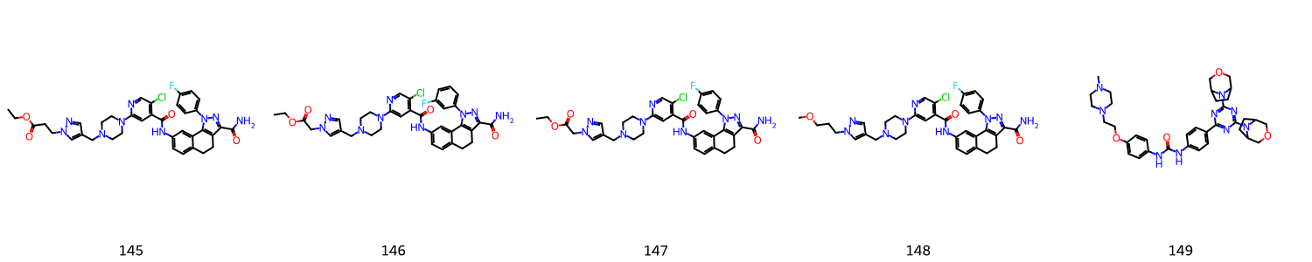
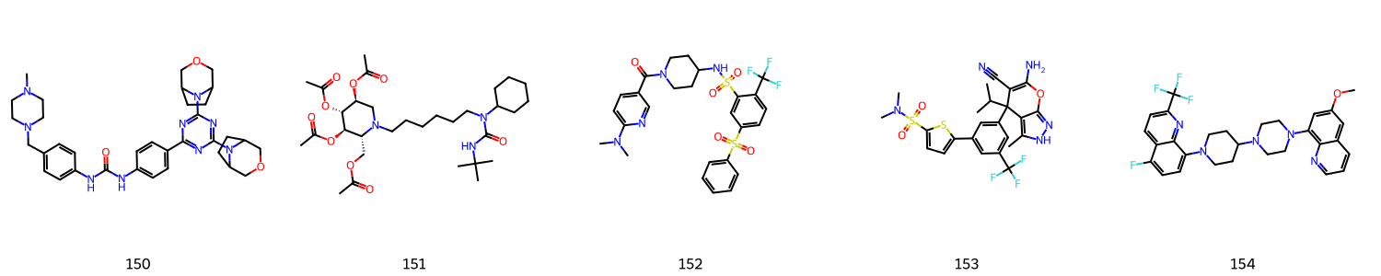
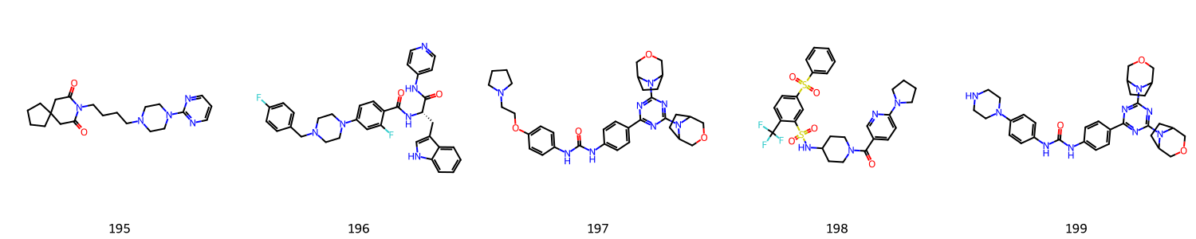
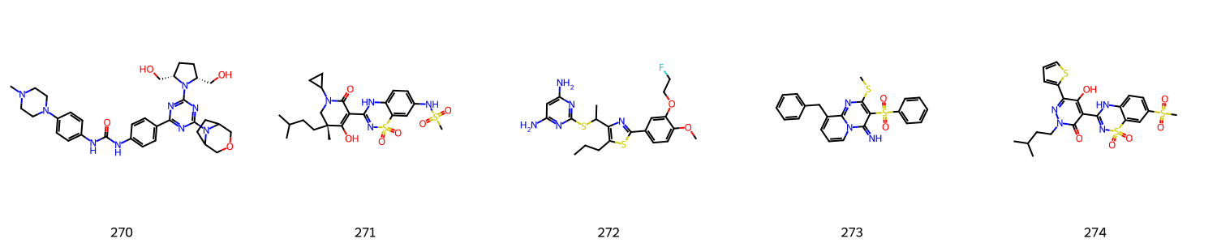
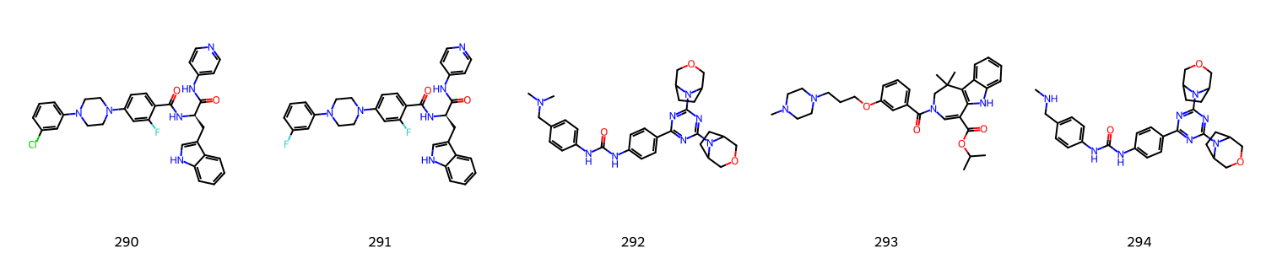
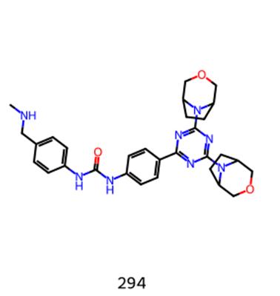
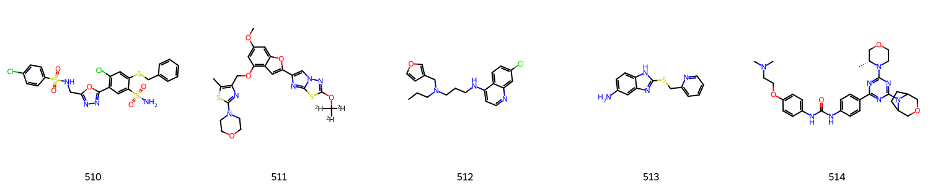
Total: 19

Slide 7
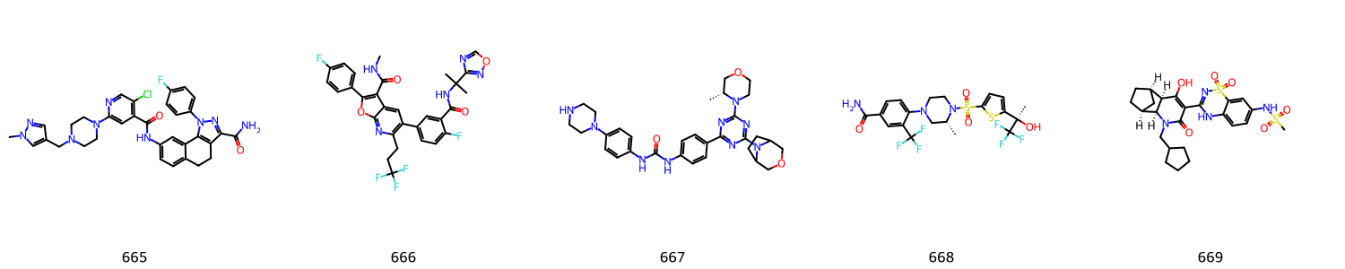
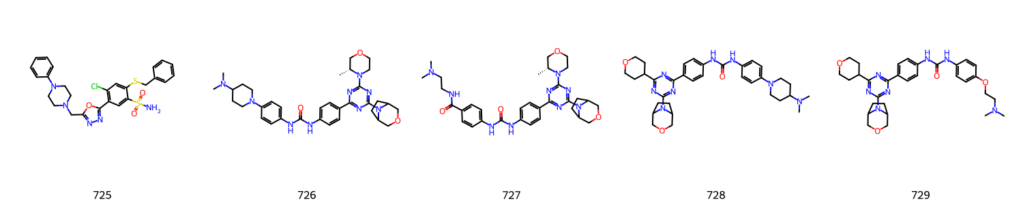
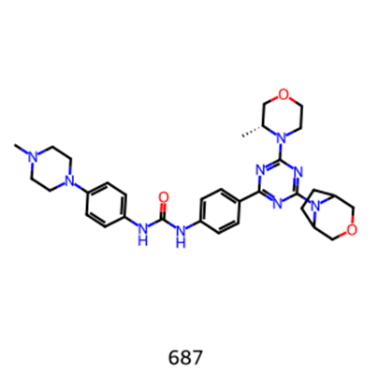
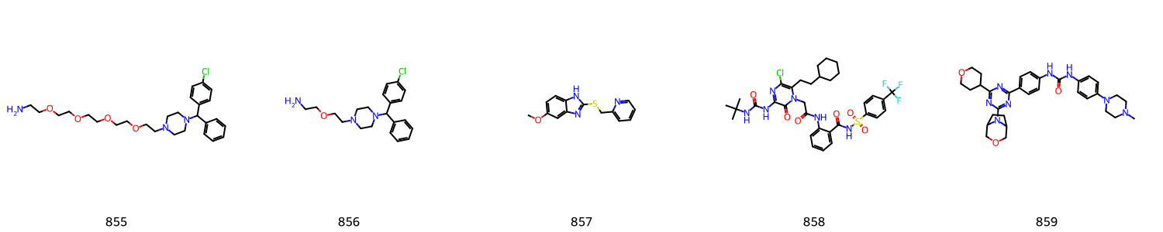
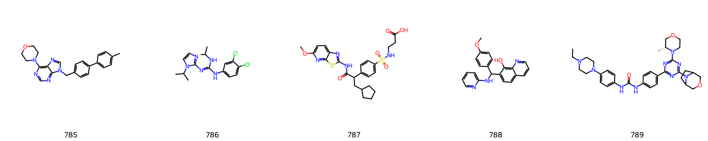
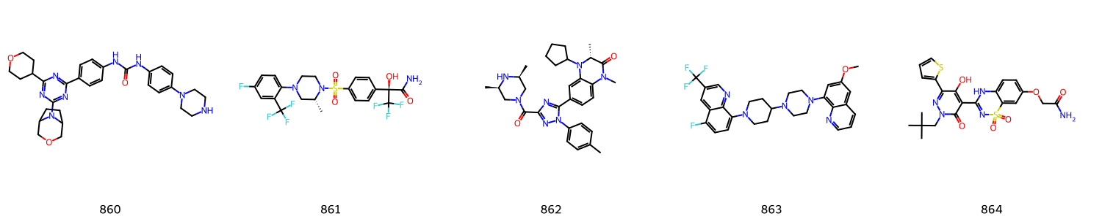

Slide 8
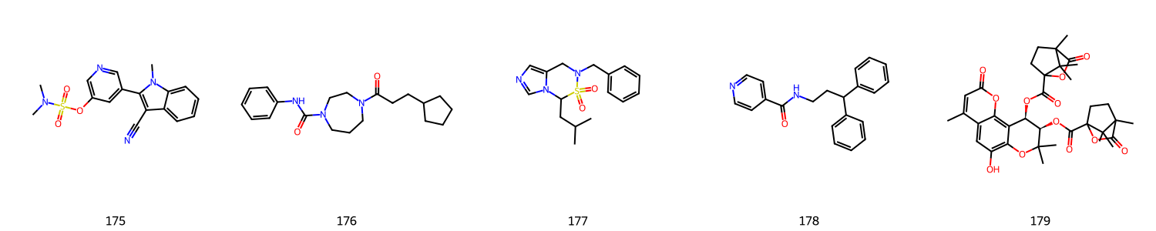
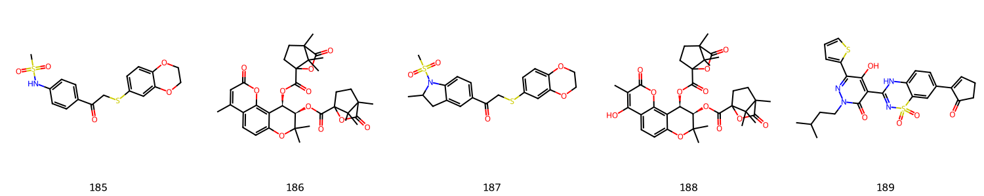
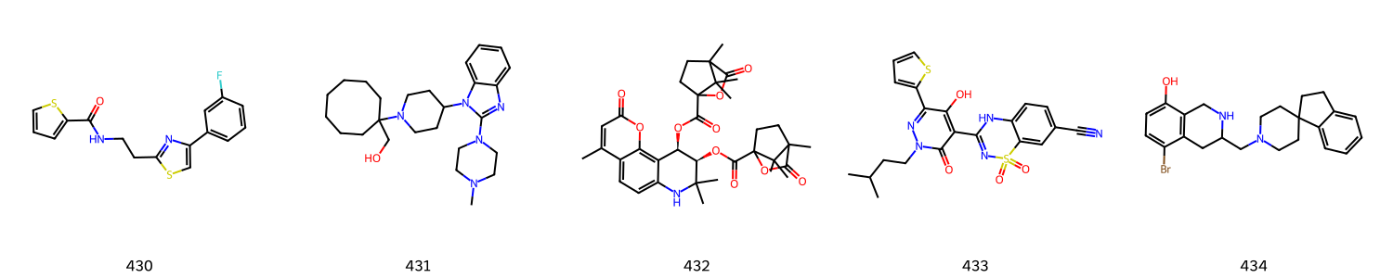
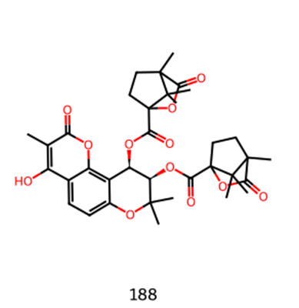
Total: 4

Slide 9
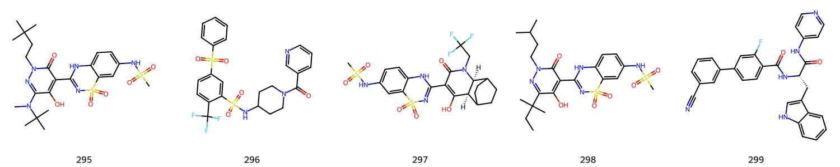
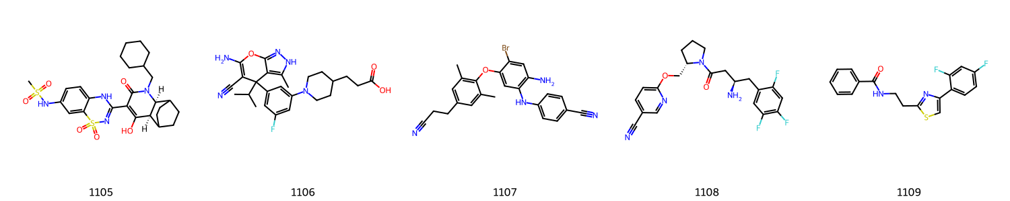
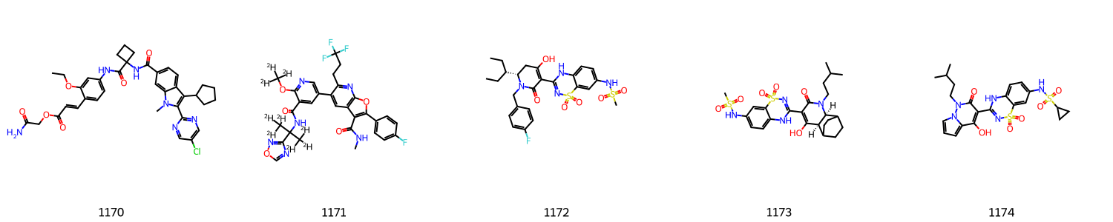
Total:3

Slide 10
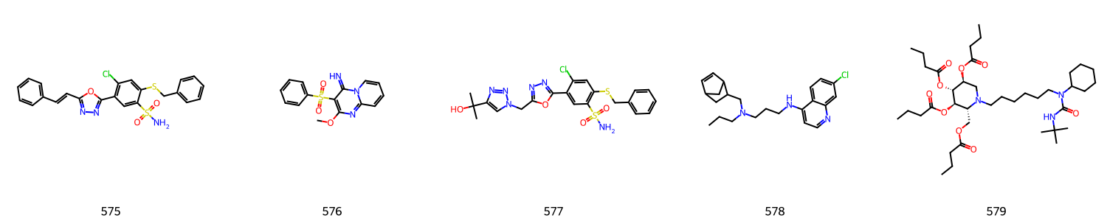
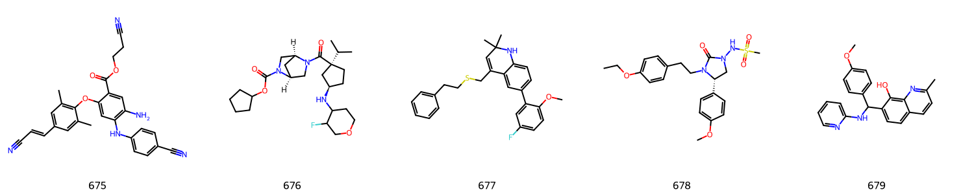
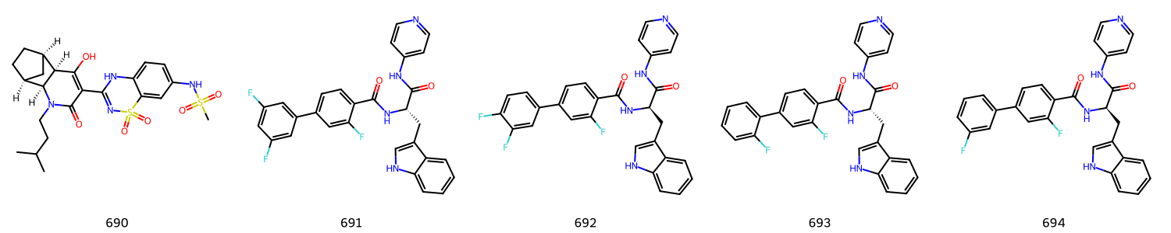
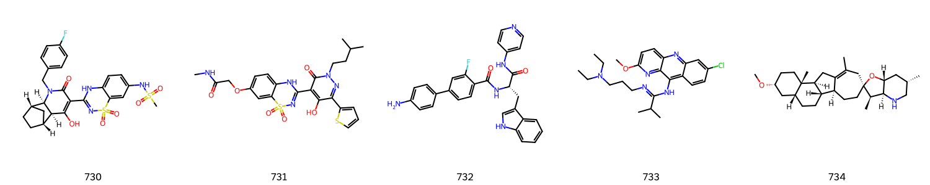
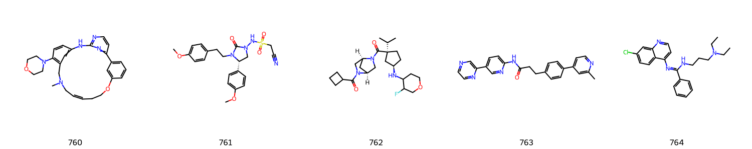
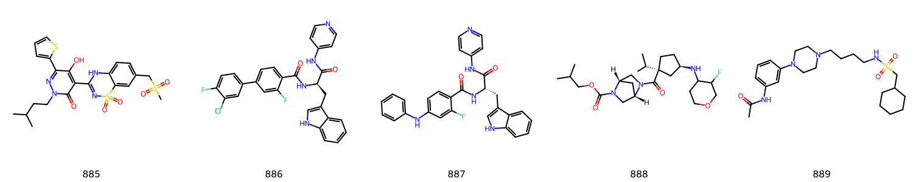
Total: 13

Slide 11
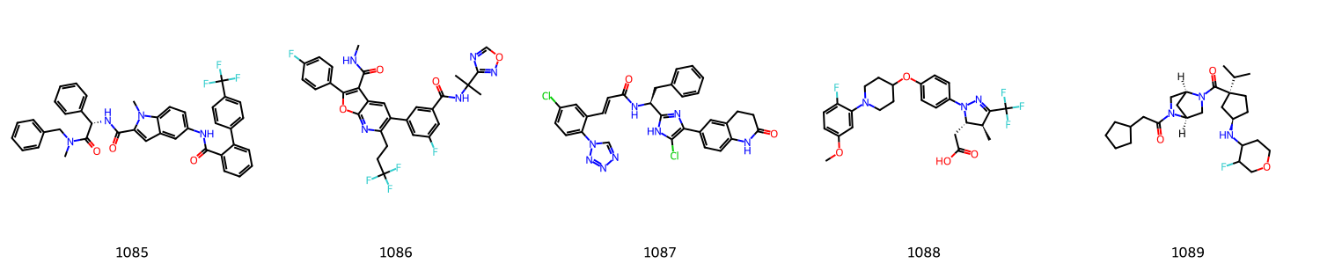
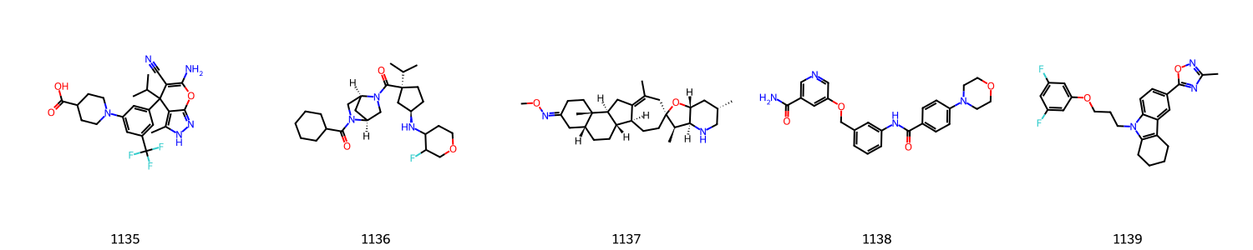
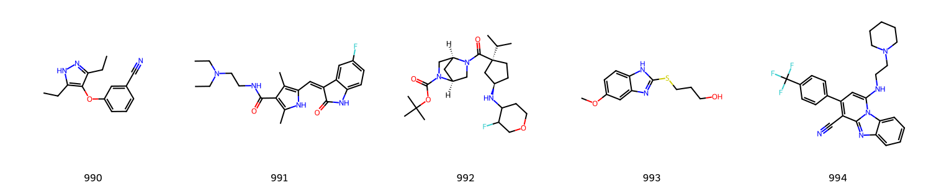
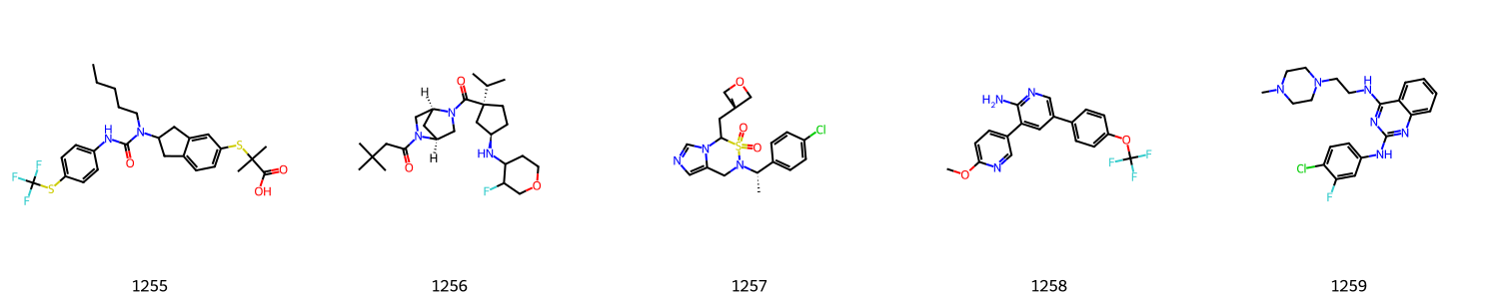
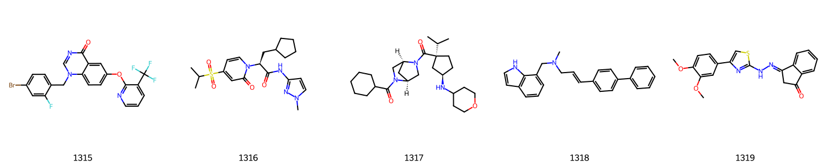
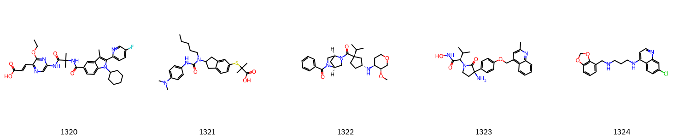
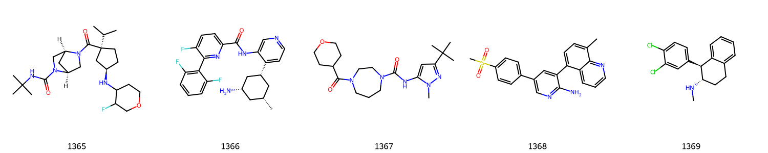

Slide 12
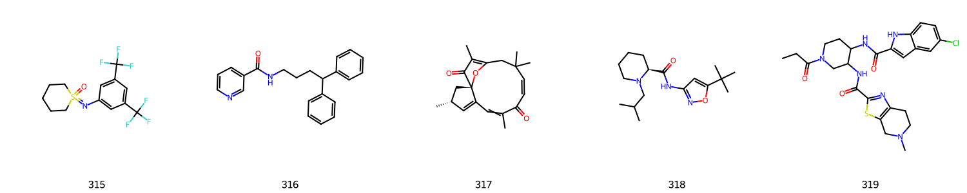
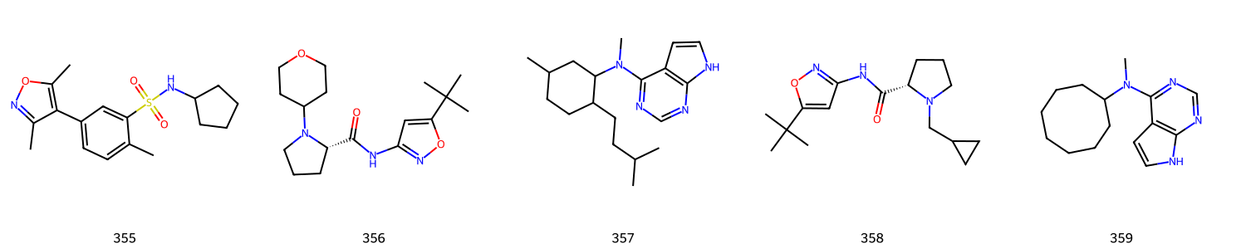


Big ring

Slide 13







Need confirm

Slide 14







Slide 15


DMPNN Remove N=3 ring- R2
Previous result
Best r2
Train: 0.9996662328571355
Valid: 0.9995614886617309
Test: 0.7003358445956377
Best r2
Train: 0.9999694703228853
Valid: 0.9999643046778764
Test: 0.7156135797634984

Slide 16


DMPNN Remove N=3 ring- RMSE
Previous result
Best RMSE
Train: 0.02391594114595351
Valid: 0.027383203909381287
Test: 0.7436954315481175
Best RMSE
Train: 0.007218157683449905
Valid: 0.008024131946602937
Test: 0.7402398537352587

Slide 17

DMPNN Remove N=7 ring- R2
Previous result
Best r2
Train: 0.9997799746850944
Valid: 0.9997249929169655
Test: 0.7125053019657133
Best r2
Train: 0.9999694703228853
Valid: 0.9999643046778764
Test: 0.7156135797634984

Slide 18

DMPNN Remove N=7 ring- RMSE
Previous result
Best RMSE
Train: 0.018721756777914666
Valid: 0.021626419326263035
Test: 0.7231905812038686
Best RMSE
Train: 0.007218157683449905
Valid: 0.008024131946602937
Test: 0.7402398537352587

Slide 19


After remove N7 ring, DMPNN model’ s prediction result, total 16/147 difference > 60 min
Graphs of these compound is continued in next slide

Slide 20




Slide 21
WWL kernel-> Wasserstein distance matrix
Convert smiles to igraph ‘s graph object
Calculate Wasserstein distance matrix: node label
1 -> all, for total 1554 compounds in dataset, matrix shape: (1554, 1554)
Now Implement: nodes label (can be continuous label)
In this case: using atom.GetAtomicNum() as node label
Wasserstein distance matrix can be used in clustering
AgglomerativeClustering
PCA, TSNE
K-means
Choosing n from 6 to 30

Slide 22

n_clusters = 13, The average silhouette_score is : 0.4186

Slide 23

n_clusters = 19, The average silhouette_score is : 0.3797

Slide 24

n_clusters = 25, The average silhouette_score is : 0.3651

Slide 25

Due to multiple rings in dataset…
“ In O-GNN, each ring is represented by a latent vector, which contributes to and is iteratively updated by atom and bond representations. ”
“ Theoretical analysis shows tha tO-GNN is able to distinguish two isomorphic subgraphs lying on different rings using only one layer while conventional graph convolutional neural networks require multiple layers to distinguish, demonstrating that O-GNN is more expressive. “

